Slide 1
Fundamentals
SOFTWARE QUALITY ASSURANCE (SQA)

Slide 2
What you will learn Today
Database Testing
Types of Database Testing
Database Functions, Joins with examples
Database designs and relationships

Slide 3
Database Testing

Slide 4
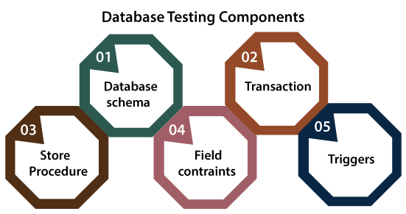
What is Database Testing?
It is the process of testing database functions, triggers, and SQL queries. Thereby validating database tables, data models, and database schema as per information provided at the User Interface.
It also checks data integrity and consistency.
It may involve creating complex queries to load/stress test the Database and check its responsiveness.

Slide 5
UI Testing vs Database Testing
User Interface Testing | Database Testing
It is generally regarded as front-end or GUI testing. | It is generally regarded as back-end or data testing.
It mainly deals with testing of functionality and responses of web application and web pages. | It mainly deals with testing of data storage and retrieval from front end to database and vice-versa.
This type of testing includes validating the: Text boxes Select dropdowns, calendars and buttons. Navigation from one page to another as well as display of images. | This type of testing involves the validating the: Schema Database tables, keys, indexes, triggers, stored procedures.

Slide 6
Why Database Testing is Important?
Database Testing is Important in software testing because it ensures data values and information received and stored into database are valid or not.
Database testing helps to save data loss, saves aborted transaction data and no unauthorized access to the information.
Database is important for any software application hence testers must have good knowledge of SQL for database testing.

Slide 7
Database Testing Types

Slide 8
Based on the function and structure of a database, DB testing can be categorized into three categories
Database Testing Types
Structural Testing
Functional Testing
Non-Functional Testing
It deals with table and column testing, schema testing, stored procedures and views testing, checking triggers, etc.
It involves checking functionality of database from user point of view.
It involves load-testing, risk testing in database, stress testing, and deals with the performance of the database.

Slide 9
Structural Database Testing
Structural database checking entails the verification of all items within the data repository that are exclusively used for data collection and cannot be directly accessed by end users. In these types of tests, database server validation is also a critical factor to remember. The testers must master SQL in order to complete this process successfully.
Schema / Mapping Testing - It entails using database object mapping to validate the objects of a front-end application.
Stored Procedures Testing - This test ensures that manual execution of stored procedure and view generate desired results.

Slide 10
Functional Database Testing
A type of database testing that is used to validate the functional requirements of a database from the end-user’s perspective. The main goal of functional database testing is to test whether the transactions and operations performed by the end-users which are related to the database works as expected or not.
Following are the basic conditions that need to be observed for database validations.
Whether the field is mandatory while allowing NULL values on that field?
Whether the length of each field is of sufficient size?

Slide 11
Non-Functional Database Testing
Comprises of load testing, stress testing, ensuring that minimum system criteria are met in order to satisfy business specifications, risk identification, and database performance optimization. Tests can include are
Security testing - It is a type of Testing that identifies the system vulnerabilities, threats, risks and prevents malicious attacks from intruders.
Stress testing - With Stress Testing evaluates the robustness and error-handling capabilities under harsh load conditions.
Load Testing - This test determines how database behaves while being accessed by multiple users simultaneously

Slide 12
ACID Properties Validation

Slide 13
Atomicity
Transactions are all or nothing
Durability
Written data will not be lost
Isolation
Transaction do not affect each other
Consistency
Only valid data is saved
Notes:
Atomicity - a transaction to transfer funds from one account to another involves making a withdrawal operation from the first account and a deposit operation on the second. If the deposit operation failed, you don’t want the withdrawal operation to happen either.
Consistency - a database tracking a checking account may only allow unique check numbers to exist for each transaction
Isolation - a teller looking up a balance must be isolated from a concurrent transaction involving a withdrawal from the same account. Only when the withdrawal transaction commits successfully and the teller looks at the balance again will the new balance be reported.
Durability - A system crash or any other failure must not be allowed to lose the results of a transaction or the contents of the database. Durability is often achieved through separate transaction logs that can "re-create" all transactions from some picked point in time (like a backup).

Slide 14
ACID
Suppose Ali has an account with an amount of RS 15000. There is Baber’s account having RS 5000. We are transferring the amount of RS 10000 from Ali’s account to Baber’s account. Now we see how we can ensure data reliability using ACID properties in DBMS.
So let us have some insight over the ACID properties in DBMS.

Slide 15
Atomicity
ACID
It simply says, “All or Nothing”. There is no intermediate.
If you are doing any database transaction (set of the read/write operations), all the operations should be executed otherwise none.
All the operation in the transaction is considered to be one unit or atomic task.
If the system fails or any read/write conflicts occur during the transaction, the system needs to revert back to its previous state.
Example:
Here, the set of operations are
Deduct the amount of RS 10,000 from Ali’s account.
Add amount RS10,000 to Baber’s account.
All operations in this set should be done.
If the system fails to add the amount in Baber’s account after deducting from Ali’s account, revert the operation on Ali’s account.

Slide 16
Consistency
ACID
Every attribute in the database has some rules to ensure the stability of the database. The constraint puts on the data value should be constant before and after the execution of the transaction.
If the system fails because of the invalid data while doing an operation, revert back the system to its previous state.
Example:
The total amount in Ali’s and Baber’s account should be the same before and after the transaction. The sum of the money in Ali and Baber’s account before and after the transaction is RS 20,000. So, this transaction preserves consistency ACID properties in DBMS.

Slide 17
Isolation
ACID
If you are performing multiple transactions on the single database, operation from any transaction should not interfere with operation in other transactions. The execution of all transactions should be isolated from other transactions.
Example:
If there is any other transaction (between Haris and Ali) going, it should not make any effect on the transaction between Ali and Baber. Both the transactions should be isolated.

Slide 18
Durability
ACID
All the previous three properties should be satisfied while the transaction in progress. But durability issues can happen even after the completion of the transaction.
So, this is the ACID Property After Completion of Transaction
The changes made during the transaction should exist after completion of the transaction.
Sometimes it may happen as all the operation in the transaction completed but the system fails immediately. In that case, changes made while transactions should persist. The system should return to its previous stable state.
Example:
It may happen. A system gets crashed after completion of all the operations. If the system restarts it should preserve the stable state. An amount in Ali and Baber’s account should be the same before and after the system gets a restart.

Slide 19
Database Keys

Slide 20
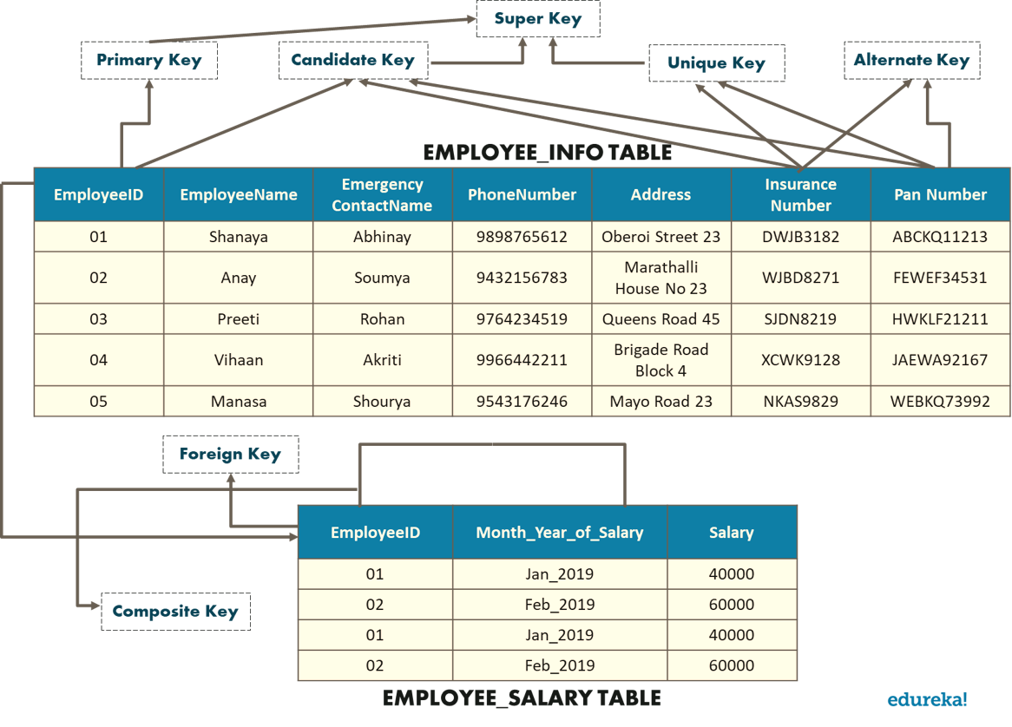
Database Keys

Slide 21
SQL

Slide 22
Database Joins
JOIN is an SQL clause used to query and access data from multiple tables, based on logical relationships between those tables
Different types of JOINS in SQL Server
INNER JOIN creates a result table by combining rows that have matching values in two or more tables.
LEFT OUTER JOIN creates a result table and includes into it all the records from the left table and only matching rows from the left table.
RIGHT OUTER JOIN creates a result table and includes into it all the records from the right table and only matching rows from the left table.
CROSS JOIN creates a result table containing paired combination of each row of the first table with each row of the second table.

Slide 23
Database Joins
SQL JOINS
LINK

Slide 24
Class Activity (JOINS)
Use this link for practicing JOINS
https://www.w3schools.com/sql/sql_join.asp

Slide 25
SQL Constraints
Not Null
Indicates that a column cannot store NULL value
Unique
Ensures that each row for a column must have a unique value
Primary
Foreign
Check
Default
A NOT NULL and UNIQUE ensures that a column(s) have a unique identity which represents a record uniquely
Ensure the referential integrity of the data in one table to match values in another table
Ensures that the value in a column meets a specific condition
Specifies a default value for a column

Slide 26
SQL Constraints
Use this link for practicing Function Queries
http://www-db.deis.unibo.it/courses/TW/DOCS/w3schools/sql/sql_constraints.asp.html#gsc.tab=0

Slide 27
SQL Functions
SQL has many built-in functions for performing calculations on data.
Useful aggregate functions:
AVG() - Returns the average value
COUNT() - Returns the number of rows
MAX() - Returns the largest value
MIN() - Returns the smallest value
SUM() - Returns the sum
Useful scalar functions:
UCASE() - Converts a field to upper case
LCASE() - Converts a field to lower case
LEN() - Returns the length of a text field
ROUND() - Rounds a numeric field to the number of decimals specified
NOW() - Returns the current system date and time
FORMAT() - Formats how a field is to be displayed

Slide 28
Functions Queries
Use this link for practicing Function Queries
http://www-db.deis.unibo.it/courses/TW/DOCS/w3schools/sql/sql_functions.asp.html#gsc.tab=0

Slide 29
Normalization

Slide 30
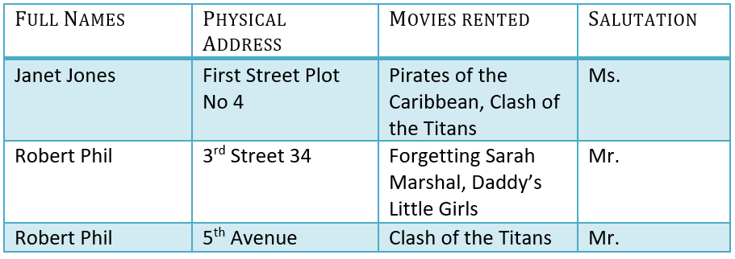
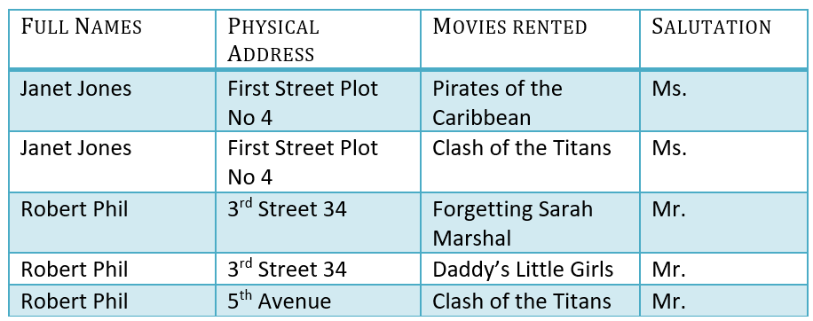
1NF (First Normal Form)
Normalization
Movies Rented column has multiple values
1NF (First Normal Form) Rules
Each table cell should contain a single value.
Each record needs to be unique.
1NF

Slide 31

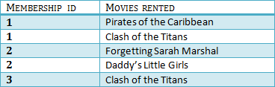
2NF (Second Normal Form)
Normalization
Rule 1- Be in 1NF
Rule 2- Single Column Primary Key that does not functionally dependent on any subset of candidate key relation
2NF

Slide 32

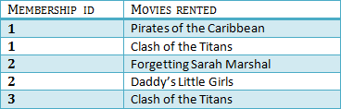

3NF (Third Normal Form)
Normalization
Rule 1- Be in 2NF
Rule 2- Has no transitive functional dependencies
3NF

Slide 33
Q&A
Instructor Notes

